Slide 1
Using Traverse Web & Mobile
October 2023

Slide 2
Introduction
Traverse is the electronic filing system that replaces paper filing folders; all case record documents are uploaded or scanned to Traverse
Some forms can be completed and approved in Traverse
Traverse receives case information from SACWIS
Traverse also has a mobile app

Slide 3
Case Content
An item maintained as part of the permanent case record is Case Content
Criminal records; letters; report cards; requests for funds; court orders; photos; hospital records; care agreements; progress reports, etc.
This Case Content is organized by Content Type
Background Check; Correspondence; Education; Financial; Legal; Media; Physical Health; Placement; Service Provider, etc.
Forms finished in Traverse are automatically added to Case Content

Slide 4
Filing Structure
Case content is scanned or uploaded to Traverse by Clerical staff according to the Lucas County Filing Structure
The Filing Structure specifies the content type where each case content item shall be stored and which date, comment and connections are to be used
When searching for specific items, key words or form numbers are searchable by pressing the CTRL and F keys simultaneously
LCCS - Traverse Filing Structure.pdf - All Documents (sharepoint.com)

Slide 5
Traverse Web
https://ohio.northwoodstraverse.com/, or
My Apps on OHID home page, or
Sharepoint home page External Links
Log in with your work email address
Then you will be prompted to enter your OHID number and OHID password
This icon on your desktop is for
Traverse Mobile

Slide 6
Landing Page Icons
The briefcase icon takes you to My Workspace, where you can find assigned work items
The bell icon is where you receive notifications if someone shares a form with you or if your download request is complete
The flower icon is where you sign in/out and under preferences, you can save and edit your Traverse signature for forms
The question mark icon is the Help button where you can find brief help articles and videos

Slide 7
Landing Page Tabs
Overview Tab – Quick view of five (recent) items for My Board, Cases, In-Progress Forms I’ve Taken, In-Progress Forms I’ve Created, and Content I’ve Finished
My Board Tab – Items you add to your Board as a shortcut that you may need to refer to often – case, person or document
Cases Tab – See all open/closed cases YOU are assigned to in SACWIS and sort by name or open date
Content Tab – Every item YOU have added to Traverse, Finished or left In-Progress and your scans and uploads
In-Progress Forms I’ve Created – Forms YOU have started, but have not yet Finished
In-Progress Forms I’ve Taken – Forms of which you have taken Edit Control

Slide 8
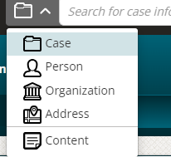
Search
The Search bar at the top of your Traverse window can help you locate cases, people, organizations, and addresses that exist within Traverse across the state
Use the drop down arrow to select the search parameter
Some search results can be filtered for “exact match”
When you expand an address search result, you will see cases, people or organizations associated with that address
Search results are limited to 100 items
The toggle will default to the last search type
You can select Content to search content added
by other Traverse users

Slide 9
Case Identifiers
All Intake Reports are identified with an “I” in front of the SACWIS Intake ID number
Provider cases are identified with a “P” in front of the SACWIS Provider Case ID number
Ongoing cases are identified by the SACWIS Case ID number
People are identified by their SACWIS Person ID number
Resource/Organizations are identified by their SACWIS Provider ID number
While all can be searched by name, those results will contain information from across the State

Slide 10
Inside the Case
Overview Tab – Quick view of five (recent) items for People, Cases, In-Progress Content, Finished Content & Events
Cases Tab – Open and/or closed cases and intakes associated to this case
People Tab – Case members, associated and reference persons; Connections (potential relationships) and Mentions (potential names from content)
Events Tab – Traverse reads content connected to this case and extracts suspected events in chronological order
Content Tab – All Finished and In-Progress content connected to this case
Insights Tab – Content mapped to concepts to help understand the factors that influence a case; the bigger the word, the more prevalent it is to the case
Add – Add form, scan or upload content to this case
Show Details – Open date, status, workers and more
Add to My Board – Select while in the case to add case to My Board for a shortcut later (e.g., if not assigned to the case in SACWIS)

Slide 11
Case History & New Content
When a new report of abuse/neglect is screened in, any remaining paper history we have with that family in Records is scanned to Traverse within 24 hours, so a family’s case history is at your fingertips
Imaged history in OnBase is in process of conversion to Traverse
Mail/Faxes and other documents are added daily on open cases
When you are assigned to a case in SACWIS, all new content added to the case, will be highlighted with a yellow bar and you will see an exclamation point with the number of new items on the Content tab
The notification is removed once you view the item(s) or click the three dots and mark as read

Slide 12
Searching & Viewing Content
25 Content items per page arranged by content date
Filter by Date and/or Content Type to search
Use search box under Finished Content to search for keywords
Keyword is highlighted in blue throughout the search results
Next button moves to the next (filtered) content item on the page without having to go in and out of each item
Some larger content items, such as audio and video recordings may need to be downloaded to view or hear them
Audio and video small enough to be viewed in Traverse without being downloaded can be converted to text with the toggle button
Toggle to text allows user to copy text to paste in another location, as needed

Slide 13
Print or Download Content
An item can be printed by opening the content and clicking the printer icon
Content items can be downloaded to a PDF by clicking the black arrow next to an item or after opening the item, select Download
Download All will download each case content item on the case (or the filtered list) in a new folder
For larger downloads, you will receive a notification upon completion and a link to the download on your notifications page
A downloaded item can be attached to an email – Select Share and Attach or save to your computer and attach from there

Slide 14
Add to My Board
To add a content item to My Board, select the button from the menu on any open content item
This will create a shortcut to the item on the My Board tab on your Landing Page
You can add comments to each item on My Board for only you to see

Slide 15
Edit Item Properties
Properties on all items scanned and uploaded to Traverse can be corrected if a mistake is made
Content Date
Content Type
Finished items added in error can only be deleted by request
An item in error might be a form that was finished accidentally before it was approved
Email details or the item link to Christina Rejent
Type “please delete” in the item comments
Items connected to the wrong case or person can easily be moved

Slide 16
Create a Work Item
A Work Item is created from the open content window
Create a due date when sending a work item to another
The item can be flagged as priority
Add a comment if you are sending to another user and want to share information about the Work Item
Add recipients, or send to yourself if creating a reminder
All Work Items assigned to you or sent by you will be found under the Briefcase icon called My Workspace
Items can be marked as New, In Progress, Follow Up or Complete and will be archived
The number in red on the Briefcase icon will indicate the number of new items you have in My Workspace
You can send yourself work items as reminders and receive a notification when they are due

Slide 17
Comments on Content
Comments help to narrow down what an item is
Service Provider-Drug and Alcohol Treatment, then “referral” or “results” in the comment helps user to decide which to open when there are multiple items under this Content Type
Comments are not yet searchable in Web, but are searchable in Mobile
Use plus sign to add a comment; use pencil icon to edit a comment

Slide 18
Connections
Connections are VERY important
Any person or case a document pertains to must be connected to that content item in Traverse
Every content item should have a minimum of one case and one person connected
Always be sure to go to the CASE when adding any content to ensure the item is always automatically connected to the case first and foremost, then connect people, etc.
Open the item and select Connections and choose from the list or select the pencil to edit the Connections
To remove connections, select the minus sign

Slide 19
+Connections-
When a document is generated during the assessment, the Intake ID, Case and Person(s) the document pertains to should be connected
When a document is generated during the ongoing case, the Case and Person(s) the document pertains to should be connected
When a document ALSO pertains to a foster parent, the Provider Case, Provider Resource, and Person(s) should be connected – IN ADDITION to the Case and Person(s) the item pertains to, such as the child and the child’s case
Traverse will list people under Connections it “thinks” you may want to connect. Once a connection is made, you can close and go back in to see additional connections Traverse “thinks” you may want. For example, connect dad, then go back in and see others who may be linked to dad show in the list as other possible connections.

Slide 20
The Person Page
Overview Tab – Quick view of five (recent) items for People, Cases, Finished Content, Cases, In-Progress Content and Events
Cases Tab – Open and/or closed cases and intakes associated to this person
People Tab – Shows relationships to this person; Connections (potential relationships) and Mentions (potential names from content)
Events Tab – Traverse reads content connected to this person and extracts suspected events in chronological order
Content Tab – All Finished and In-Progress content connected to this person
Insights Tab – Content mapped to concepts to help understand the factors that influence a case; the bigger the word, the more prevalent it is to this person
Add – Add form, scan or upload to this person (not recommended-go to Case)
Show Details – Demographic information, SACWIS Person ID and more
Add to My Board – Select while on the person to add that person to My Board for a shortcut later

Slide 21
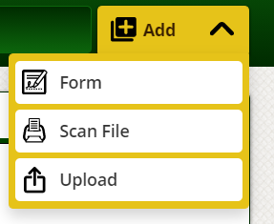
Add
Scan File – Records Clerk responsibility
Upload – Caseworkers should forward email items with attachments to their Records Clerk to upload, but case workers also have the capability to upload items
Clerical process requires emails from workers to be prioritized at the top of their inbox and uploaded to Traverse within two days and stored in an Uploaded Mail folder
Clerical Assistants upload photos, letters, faxes and more
Be sure to provide identifying information to your clerical to ensure content is connected to the correct case/person

Slide 22
Add - Upload
Determine what the item is that needs to be uploaded and identify the Content Type
Go to the Add button on the CASE, select Upload
Search for and select Content Type
Drag the file over or select Browse to search for and select the location of the document to be uploaded
Choose content date, add comment if necessary, make the connections and upload the file
Go back and review the uploaded item to ensure the document uploaded successfully

Slide 23
Add - Form
Open CASE
Select Add Form
Search for form only under Lucas (17), JFS or ODM (10221 – Standard Authorization Form); do NOT use other county forms
Add Connections
Fill out fields, including all required fields; forms cannot be finished unless all required fields are completed
Form can be deleted up until FINISH has been selected-but, if signed, delete signature, then delete form
Form remains In-Progress until FINISHED
SHARE a form that is In-Progress to obtain approval/signature
Once a form is FINISHED, it becomes permanent case record and is uploaded automatically to the correct Content Type; can only be deleted by request
Comments can be added after the form is FINISHED

Slide 24
Sharing Forms
Share a form created in Traverse when approval or review is needed by another person (supervisor)
Select the Notes tab on the form to mention the other person’s name by typing the @ symbol and the person’s name
The other user will receive a notification in Traverse immediately, if they have Traverse open; otherwise, an email will be sent to them within 20 minutes
Before the other user makes a change or signs a form, they must Take Edit Control of the form and then Release Edit Control to send it back to the creator
A form cannot be changed once a signature has been applied; delete the signature to make a change and share it again, if needed
The creator will find the In-Progress form on their own Landing Page or In-Progress content on the case content page
The creator will Take Back Edit Control and share it with another, or select the Finish button if the form and approval process is complete
To edit forms in the Mobile app, the user must have edit control in the web program
When the Lucas County Request for Funds is Finished, the creator must email JFS Lucaskids-Fiscal with the case information to be processed

Slide 25
In-Progress
Items are In-Progress until they are Finished in Traverse
In-Progress Content you created can be found on your landing page or case or person content page
These items can be seen by others, and edited by anyone who has access and selects Take Edit Control of a form
Notes can be added to the reviewer who is mentioned with the @ symbol
The person who created the form, or a person who was mentioned in the form can Finish the form
If someone other than the creator finishes a form, the creator will receive a notification

Slide 26
Copy & Create a New Form
After a form is created and finished in Traverse, a duplicate form can be created to avoid typing the information a second time
For example, use this feature to create a JFS 1616 Social and Medical History form for multiple children or when an update is needed to an existing form created in Traverse, such as a Lucas County Child Study Inventory

Slide 27
Notification Center
The bell icon to the right of the search bar is the Notification Center
These notifications can be filtered by sender, notification type, and read/unread status
The user can select or filter items and mark them as read or delete them
Notifications are received when you are mentioned in a form, a form is handed off to you from the mobile app, someone released edit control back to you, a form you created has been finished by another, or a bulk download you initiated is ready
When you receive any of these notifications, a red badge will appear on the notification center
For form-related notifications, an email with a link to the form will also be sent if the user has not already opened it in Traverse after 15–20 minutes

Slide 28
Mobile App

Slide 29
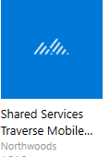
Traverse Mobile
Download Traverse Mobile from the Software Center if the program is not already installed
Mobile can only be used after a successful login to Traverse Web
The login name and password is the same as web
On initial login, the app must be allowed to update so all forms and features are downloaded; this may take some time and is not complete until the status icon stops spinning
After the initial sync, case content can be downloaded

Slide 30
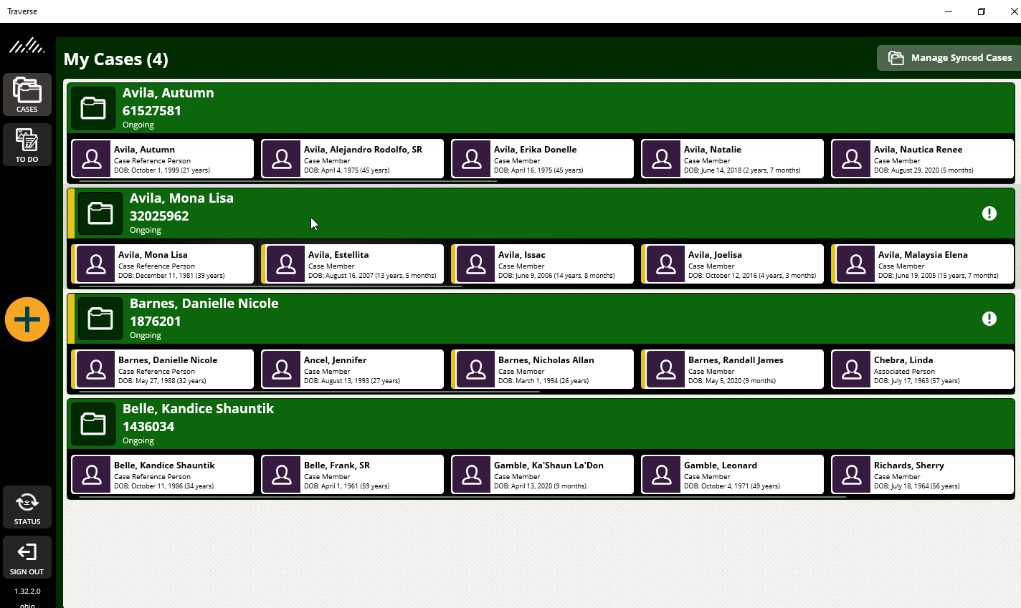
My Cases
Selecting the “mountains” or Cases will take you to your home page in Traverse Mobile
Here, you see cases synced (downloaded) to mobile – NONE at first login
Select Manage Synced Cases to add a case to your device

Slide 31
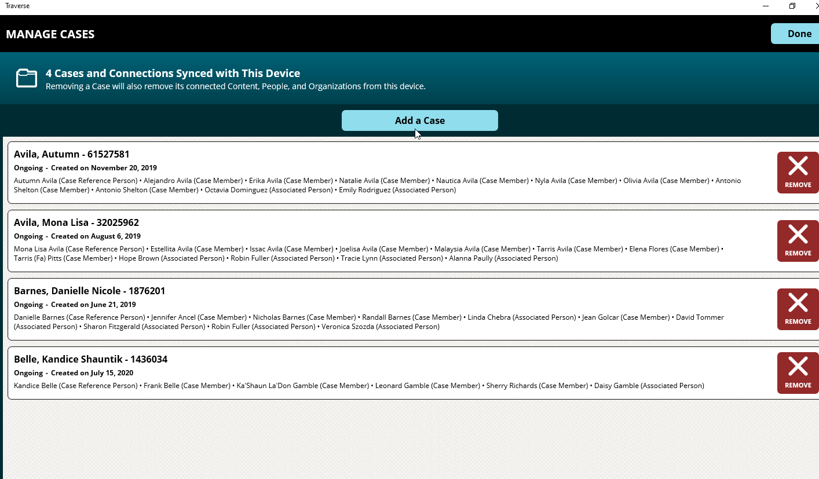
Manage Synced Cases
When you select Manage Synced Cases, you will see nothing at first login. Select Add a Case

Slide 32
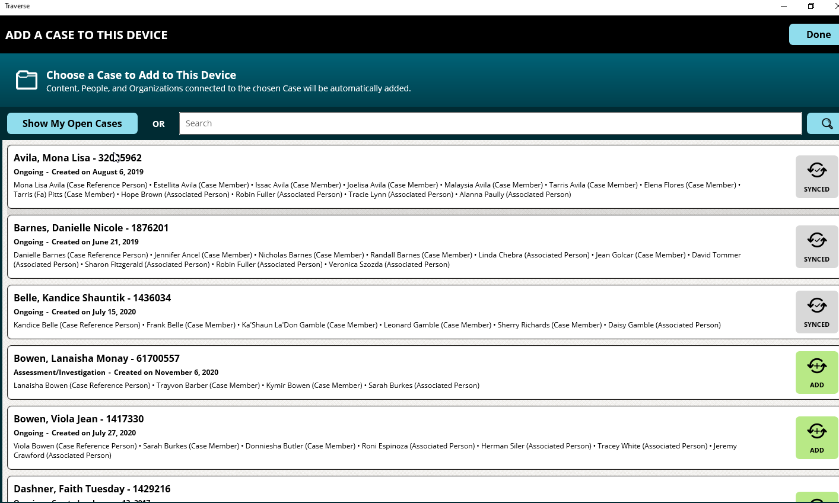
Add a Case
Select Show My Open Cases. You will see cases you are assigned to in SACWIS and you can choose to download them by selecting the green ADD button (you may also search for the case ID in the search bar if not assigned in SACWIS

Slide 33
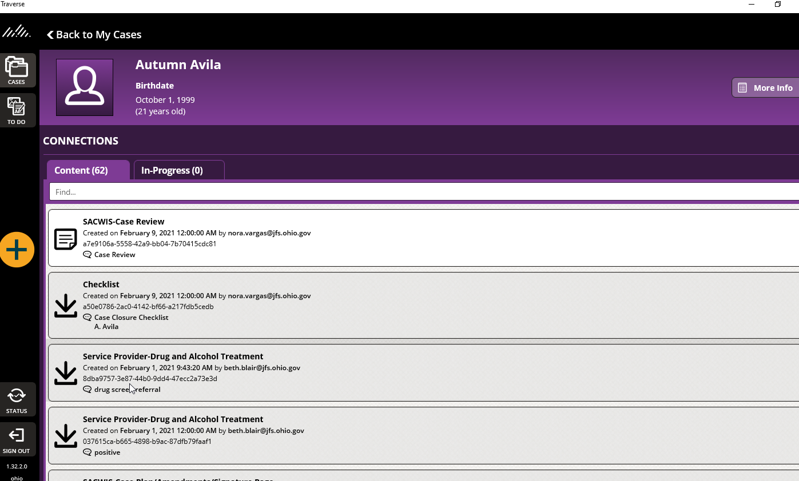
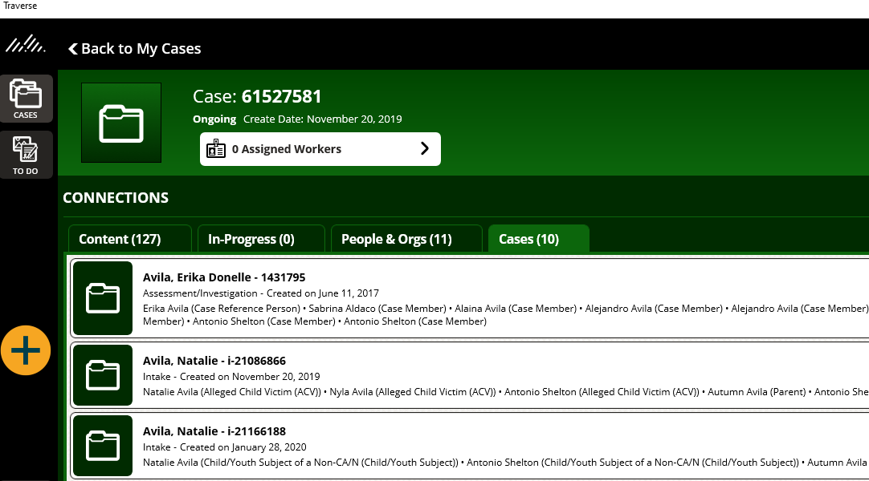
My Cases
After you download a case, it is found under My Cases. You can click on the case to go to case content or click on a person to go to person content

Slide 34
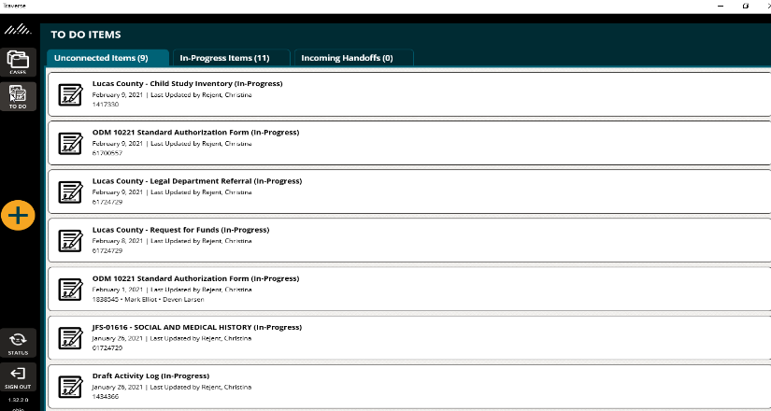
To Do Items
Here, you will find Unconnected Items, In-Progress Items and Incoming Handoffs
When in web, you will see these same items under In-Progress Forms I’ve Taken and In-Progress Forms I’ve Created.
Unconnected Items must have connections before they can be finished
To edit a form in Mobile, the user must Take Edit Control in web

Slide 35
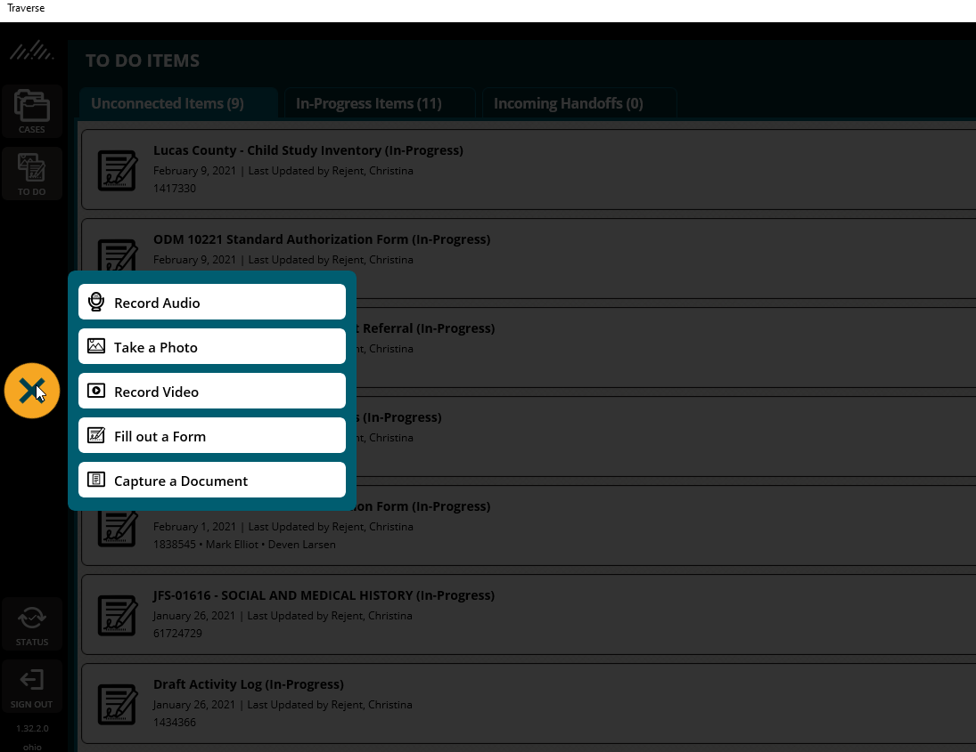
Add Button
Select yellow add button (+) to Record Audio, Take a Photo, Record a Video, Fill out a Form or Capture a Document and click the (X) to cancel

Slide 36
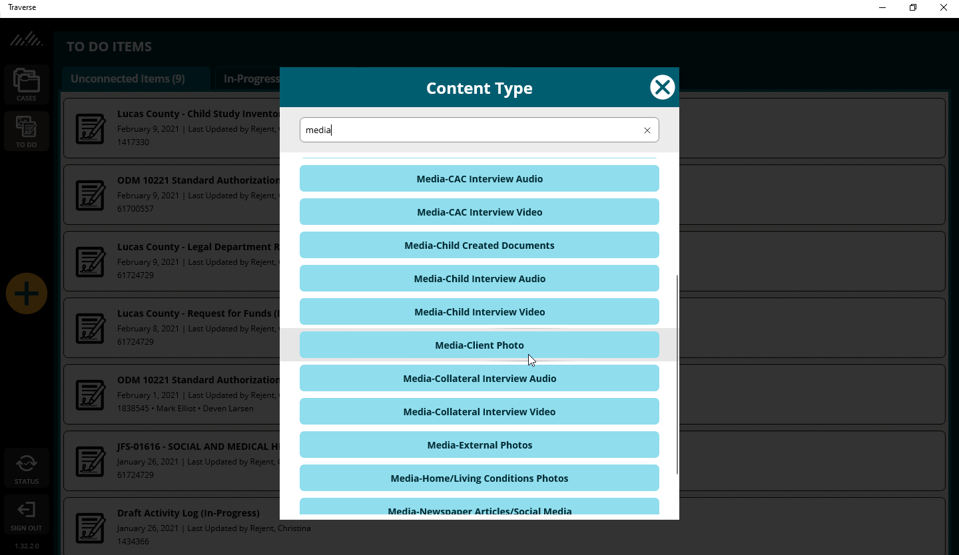
Take a Photo
If you choose to take a photo, or make a recording, you will be prompted to select the Content Type

Slide 37
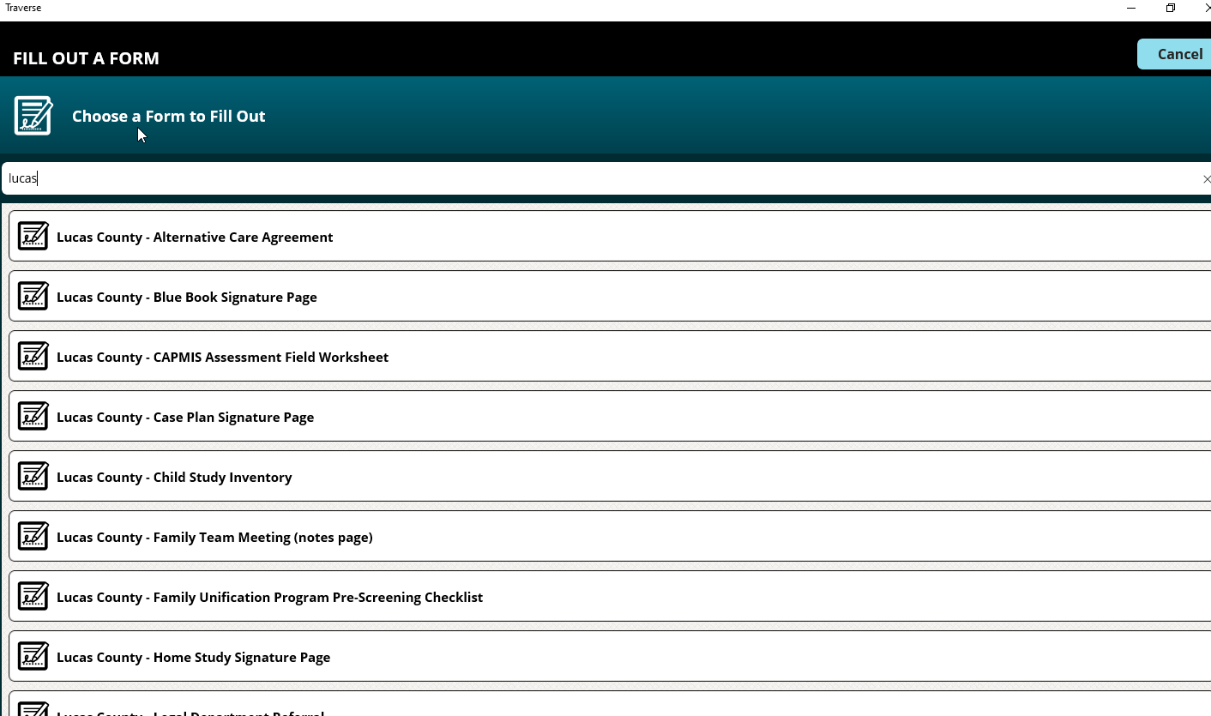
Fill Out a Form
When choosing to Fill out a Form, you will prompted to select the form from the list. That process is the same in Web and Mobile – make connections and use the Hand off feature or Finish the form if approval is not needed

Slide 38
Mobile Updates & Sync
Traverse Mobile will update new content and forms at login with internet access
Once the status icon stops spinning the app is current
Downloaded case content can be viewed without an internet connection

Slide 39
Tips for Web & Mobile
Always add content while in the CASE, not the person page
Copy & Create New form to avoid typing everything again or to apply an update to a finished form created in Traverse
Documents can be moved to the correct case by searching for the correct connection and removing the incorrect connection
Do not use SACWIS Draft Activity Log form in Traverse!
When you open a case or content item in Mobile, use the Focus button to lock the screen so no one can get on your device and move to another screen; take it out of Focus by clicking it again and typing Ohio as the Organization Name
After initial log in, let mobile sync – until status icon stops spinning (keep device awake, as sync may not occur during sleep mode)
Web benefits – friendlier environment, create form, upload/scan and search content, Insights, Mentions and Events
Mobile advantage: record audio, video, take photos, document capture, obtain signatures on the device
LCCS forms website – www.LCCSOH.org
Tutorials - Traverse

